Slide 1

Tell us who your friends are
and we’ll tell you what to eat
Asaf Bazir
Asaf Sasson
Shachar Petkovski

Slide 2

Introduction

Slide 3
Our Product
Cheffo is a location-based application for ordering home-made food.
Our mission is to make food ordering more accessible, simple and quick.
With Cheffo we’ll provide job opportunities for home chefs and suggestions-based system for users.

Slide 4
System Architecture
Users
Auth System
Resolver
Mobile App
Chefs
API Gateway
Database
Web UI
Models

Slide 5






Technologies
Client Side
DataBase
Server Side
React & React Native

Slide 6
Cheffo Interface
Cheffo App
Cheffo Server
981
3867
1915
Lines of code

Slide 7
Network
Aside from food ordering, Cheffo includes social network:
Follow/Unfollow users
Friends suggestion system
Weighted chef rating that changes according to your friend’s reviews
Feed that shows your friend’s reviews

Slide 8
Algorithmics
The suggestion system calculates the suggestions applying BFS-based algorithm on the data with depth 3 and saves the depth of each node
Each user that is not your friend gets a score based on the depth from you, the location from you and the number of appearances in the result of the BFS

Slide 9
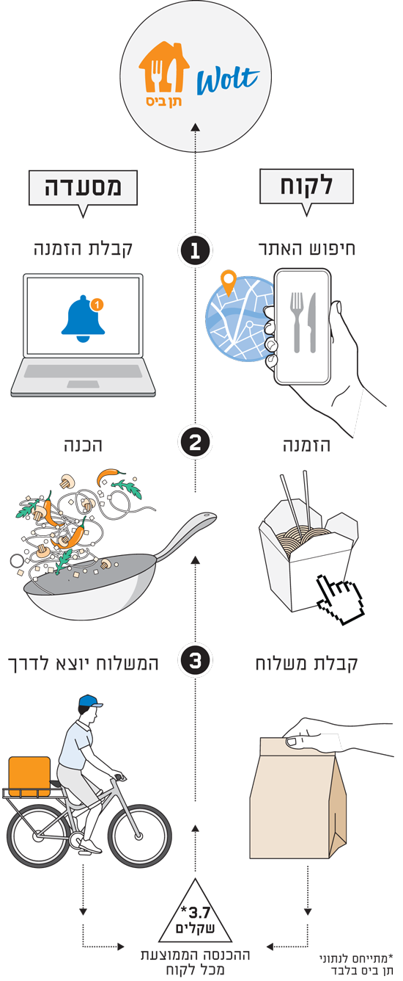
Business Model
Free to use for users
20% commission from orders
First order discount
Gift coupon for friend affiliation
שף
לקוח

Slide 10
Thank you for listening, any questions?

